Slide 1

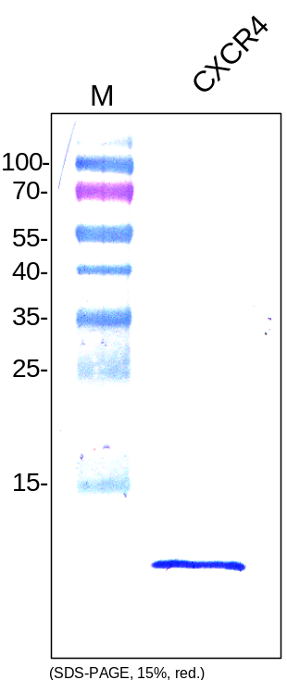
ReliaTech GmbH
Anti-human CXCR-4
(Cat#102-PA120)
Figure 1: Western analysis of recombinant human CXCR4 fusion protein produced in E. coli.
http://www.reliatech.de / orders@reliatech.de

